Slide 1
ArcGIS Earth Essentials
Basics of ArcGIS Earth. MUST be viewed as a slideshow to see the process flow. Run it Auto or with the timings turned off. (Slide Show | Use Timings | Total Time: 8 min)
Ref: https://learn.arcgis.com/en/projects/get-started-with-arcgis-earth/lessons/explore-the-world-with-arcgis-earth.htm
ACKNOWLEDGEMENT
This presentation is derived from the above page, with navigation and explanations added to simplify the learning process. While the presentation in its entirety remains the property of NCI, the knowledge base and some graphics in the above URL are owned by ESRI
Copyright © 2019-2020 by National Computational Infrastructure, Canberra, ACT, Australia. Author: Dr. Arapaut V Sivaprasad.
Created: 15 January, 2018; Last edited: 16 March, 2020

Slide 2
INTRODUCTION
This presentation is an evolving document to learn ArcGIS Earth and to incorporate GSKY. Firstly, a basic tutorial on how to add map and layers will be shown. Adding layers from public repositories, local files and online URLs (the latter is for GSKY) will be demonstrated.
Using ArcGIS Earth to display GSKY layers is then explored.
SYSTEM REQUIREMENTS
Windows 7 to 10 (64 bit [EM64T])
Microsoft .NET Framework 4.6.1
Microsoft Visual C++ 2015 Redistributable Update 3.
Direct3D feature level 9_3
Default: DirectX 11 hardware support
Falls back to DirectX 11 software rendering if hardware support is not available
CPU speed: 2.2 GHz or higher
Hyper-Threading Technology (HTT) or multicore
Memory/RAM: 2 GB or higher.
Display: 24-bit color depth.
Screen resolution: 1024x768 or higher
OBJECTIVES
Install ArcGIS Earth on local PC (Windows only).
Learn the basics of ArcGIS Earth (“AE”).
Find out whether it is the client we need for GSKY.
Get layers added to AE from GSKY.
AUTHORISATION
ArcGIS Desktop Advanced_Single User Licence
https://arcgis.anu.edu.au/arcgis-pro-installing.html
Downloads:
https://wattlecourses.anu.edu.au/course/view.php?id=21946
Activating ArcGIS Pro on an ANU desktop computer
Activating ArcGIS Pro on a laptop
ArcGIS Online account
https://ausnatuni.maps.arcgis.com/
DISCLAIMER
This is an attempt to use ArcGIS with GSKY before certain anomalous behaviors of GSKY and ArcGIS were known. See GSKY_ArcGIS_Integration.docx that explains in a better way. A complete lack of feedback from other users, though solicited, may be reflected in this presentation as confusing especially in slides 9-10.
Next: Install ArcGIS Earth

Slide 3
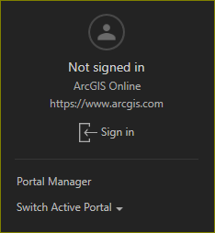
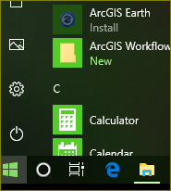
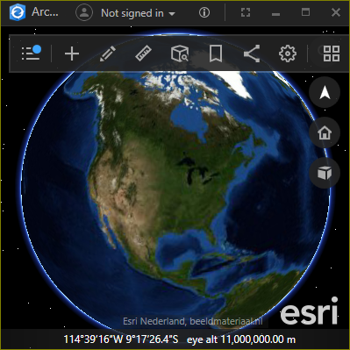
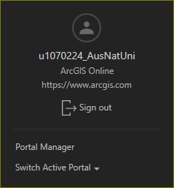
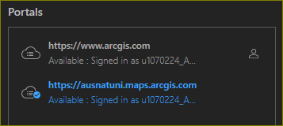
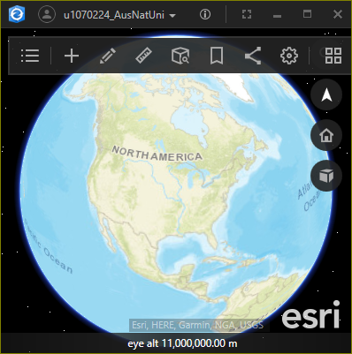
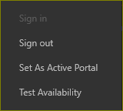

Software Installation and Setup
The ArcGIS Earth is included in the ArcGIS Desktop licence. However, it does not get installed automatically. To install on Windows 10, do the following.
This and all remaining slides must be viewed as a slide show.
STEPS
Start | ArcGIS Earth
Install and run
Sign in with ANU licence
Set an active portal
Next: Start the tutorial

Slide 4
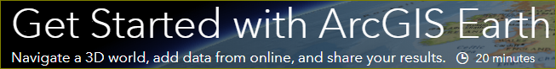

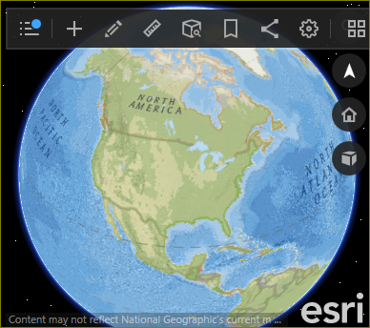

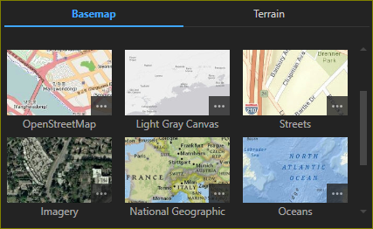
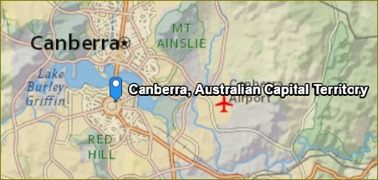
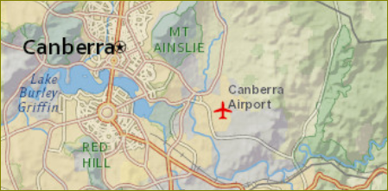
Basemap and Explore
In this lesson, you'll explore the world with ArcGIS Earth, a streamlined desktop application that displays 2D and 3D data from around the globe. You'll add map layers from files and the ArcGIS Living Atlas of the World, then pan, zoom, and tilt to view them. Your exploration will encompass Canberra, Mount Everest, Tokyo and several other locales. When finished, you'll share your map data via email.
Change the basemap and terrain
Zoom to a location
Next: Bookmark and Play

Slide 5
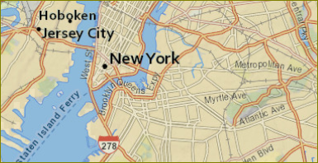
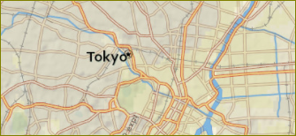
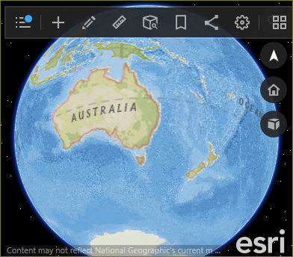

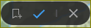
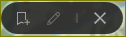
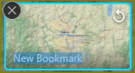
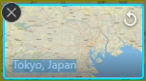
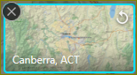
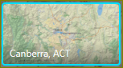
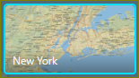
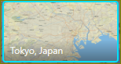



Bookmarks
Bookmarks are useful to go back to any point in the project.
Bookmark the current location.
Find two other locations and bookmark.
Cycle through bookmarks
Delete bookmarks.
Zoom out to home.
Next: Add data from living atlas

Slide 6
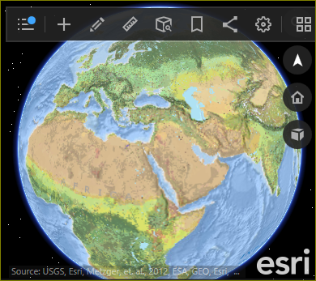

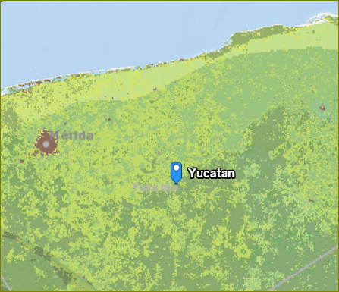
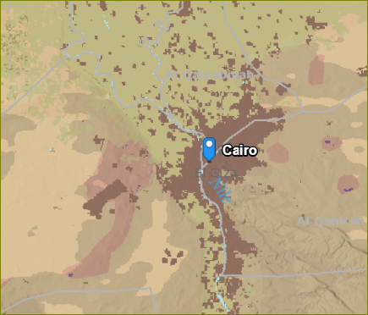
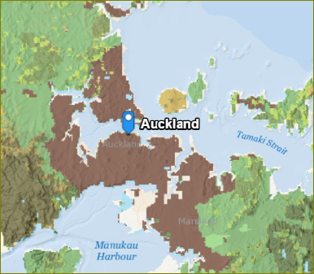
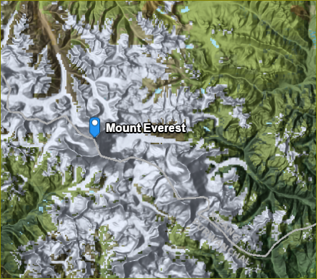

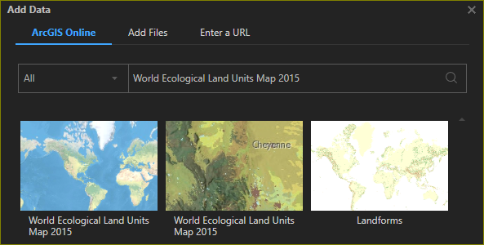


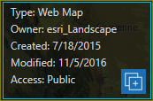
Add data from living atlas
Add a world ecological data layer.
Zoom to various places.
Next: Add data from files

Slide 7
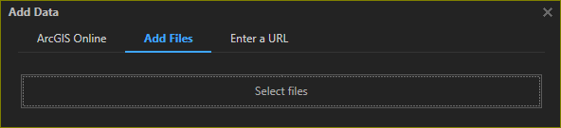
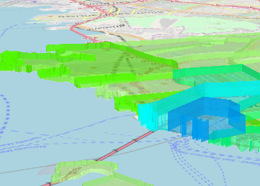
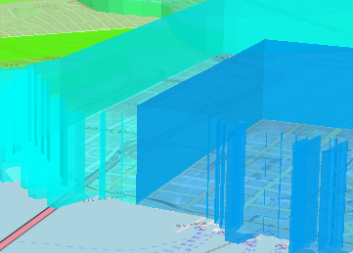
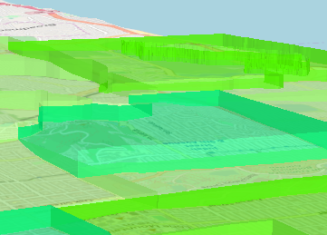
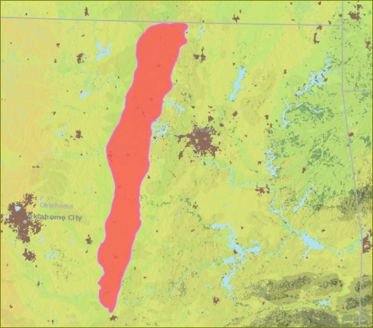
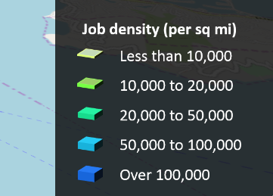
Add data from files
Add a KMZ file.
Add a SHP file.
Next: Add data from online

Slide 8
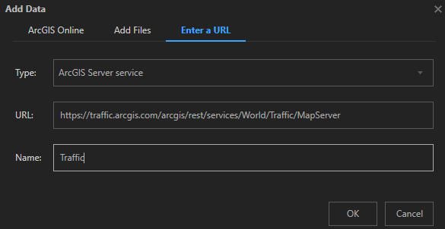
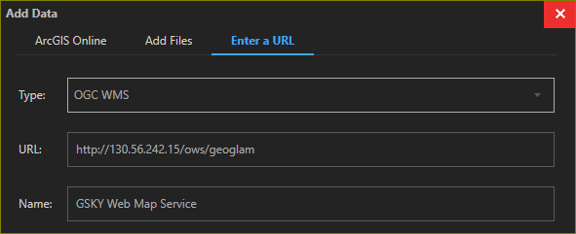
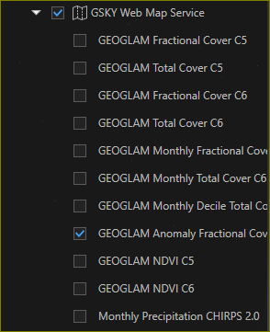
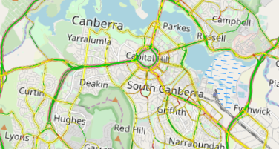
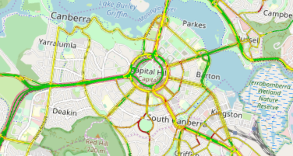
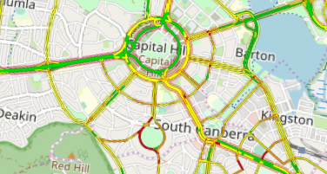
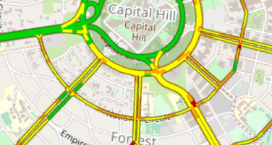
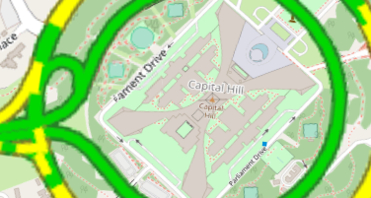
Add data from online services
World Traffic Service
GSKY Map Service
Error at GSKY Server
The above error was due to a recent upgrade of PostGIS that broke the MAS server used by GSKY. Reversing the upgrade solved the error. See next slide.
Next: GSKY Web Map Service

Slide 9

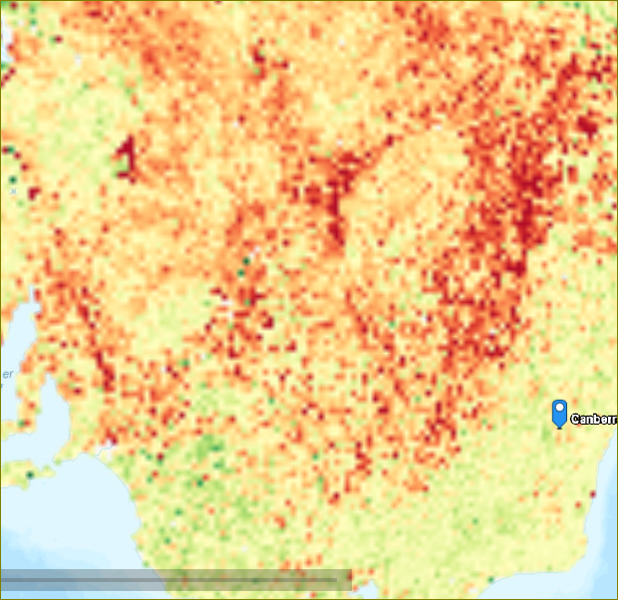
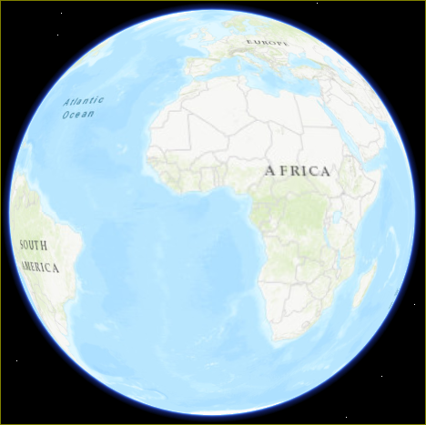
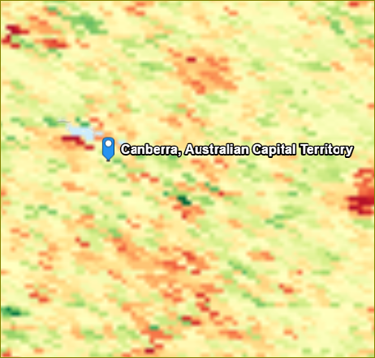
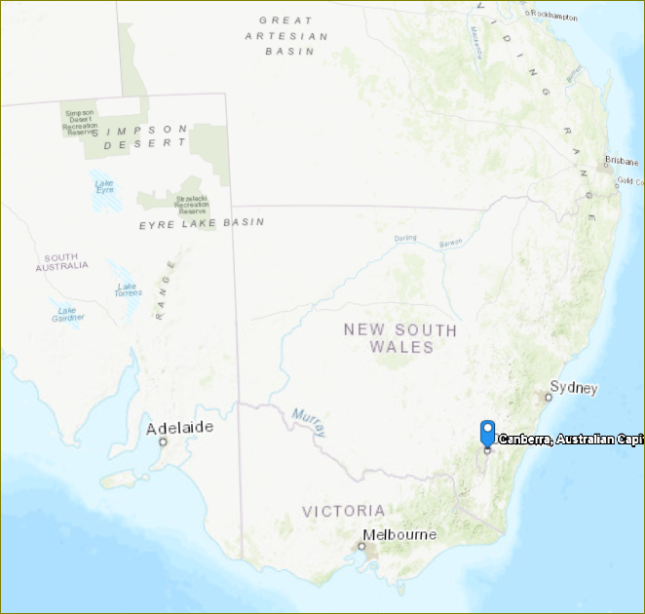

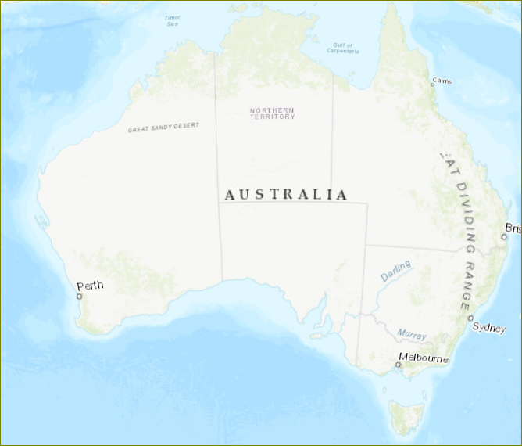
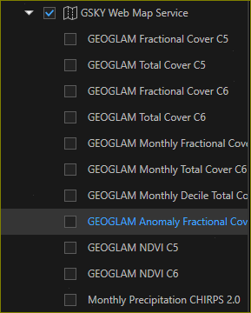
GSKY Web Map Service on ArcGIS
This section is about the use of ArcGIS and GSKY together, and will describe the usage, errors and solutions, bugs, etc.
Display GEOGLAM through ArcGIS
1. Expand the “GSKY Web Map Service”
3. Check ‘GEOGLAM Anomaly Fractional Cover”
4. Search for “Australia”
4. Search for “Canberra”
5. Zoom out to see more area
6. Zoom further out
The layer disappears. It is due to wrong bounding box values returned by ArcGIS. See next slides for details.
Next: Zooming error in ArcGIS

Slide 10


Zooming Error in ArcGIS
ArcGIS fails to display GSKY layer at lower zoom levels
Returned Bbox - Correct
Required Bbox at lower zoom
Returned Bbox at lower zoom
The reason why the GEOGLAM layer disappears when zooming out can be due to two reasons:
The zoom level has exceeded the specified resolution. In this case, it will show “Zoom in to see this layer”. This is not an error.
Some other error preventing the display.
Extensive analysis through the logs and return values revealed that the bounding box values sent by ArcGIS suddenly go into error after certain zoom level. This makes GSKY unable to send data corresponding to the zoomd display.
With the returned wrong Bbox, GSKY tries to get the data but fails. It appears to be an ArcGIS problem, but may not be. Testing with some third party WMS service did not show this problem, but then we do not know what kind of data they send.
This requires further verification.
Working (example only):
bbox=12412605.148096,-5114576.678347,19033220.382848,-1122814.524425 &width=512&height=309
Wrong Bbox (actual shown):
bbox=-20037508.342789,-4941377.708652,-18785164.071365,1878516.407136&width=94&height=512
End of Slides

Slide 11






Acknowledgements

